Slide 1

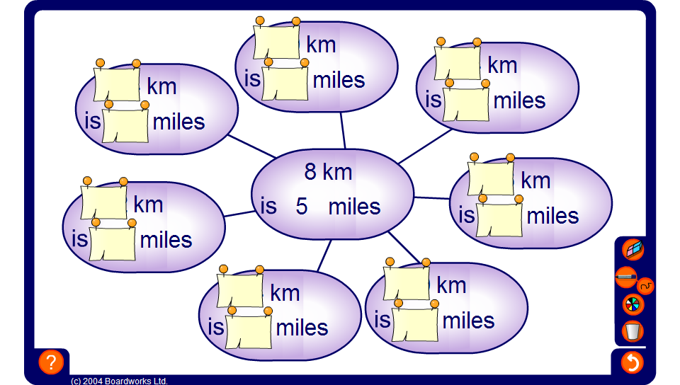


Direct proportion spider diagrams
Notes:
In the activity pupils must use proportional reasoning to convert the units in the spider diagram.
Uncover one of the units in each circle and ask pupils to find the other one, explaining their reasoning.

